Slide 1
DETERMINING GLYCEMIC LOAD WITH IMAGE CLASSIFICATION
Guided By – DR. PS Dhabe
18 - Abhijit Gawai
29 - Shyam Kawale
43 - Nishant Bhat
50 - Bhargav Pawar
55 - S. Abhishek

Slide 2
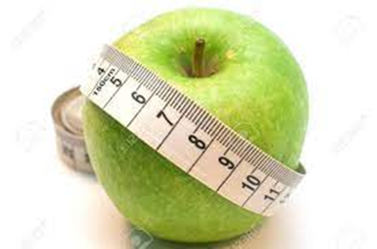
WHY DO WE NEED TO MONITOR OUR FOOD INTAKE?
Healthy diet with balanced nutrition is key to the prevention of life-threatening diseases such as obesity, cardiovascular disease, and cancer.
High-calorie intake can be harmful and result in numerous diseases like obesity, diabetes among others.
So, it reflects that the measurement of daily meal intake is quite essential to lose weight as well as to preserve the healthy weight for ordinary people.
To accomplish this task, a mechanism is required that empowers the patients with a long-term solution and guide them to achieve constant and lasting changes to their dietary quality and calorie intake.
Fig 1. Fruit Image

Slide 3
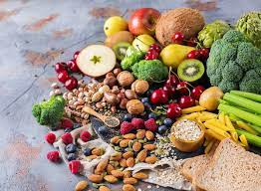
PARAMETERS USED
Dietary Fibre
Glycemic Index
Glycemic Load
Calories
Protein
Fat
Fig 2. Multi Fruits

Slide 4
LITERATURE REVIEW
[1] Calorie Prediction from Food Images, Manal Chokr, Shady Elbassuoni
Estimate the calorie content of the food item like pizzas, doughnuts, chicken, sandwiches
[2]Semi-Automated System for Predicting Calories in Photographs of Meals, Patrick McAlister, Huiru Zheng, Raymond Bond, Anne Moorhead
Users had to draw manually around the boundaries of the food image.
Drawn section compared with the dataset to get the calorie content.
High accuracy

Slide 5
LITERATURE REVIEW
[3] Ashu Gulati, Rahul Samant, Tushar Tank (2020), Calorie Estimation System Using Object Detection by Deep Learning Technique, International Journal of Future Generation Communication and Networking Vol. 13, No. 2s, (2020), pp. 1532–1537
Dataset – Manually collected form images.google.com (500 annotated images of 6 classes ) of Bhaji(vegetable), Dal(curry), Rice, Roti, Puri and Gulab Jamun.
Algorithm - YOLO V3 for food detection
Method - Standard calorie values except for rice
For rice calculate the area
With the reference of the dimensions of the coin which is already known, we will get the dimensions of the plate through OpenCV modules such as scipy, argparse, imutils, numpy, cv2 etc.
Fig 3. Area of rice calculated according to coin

Slide 6
Fig 4. Flow of algorithms

Slide 7
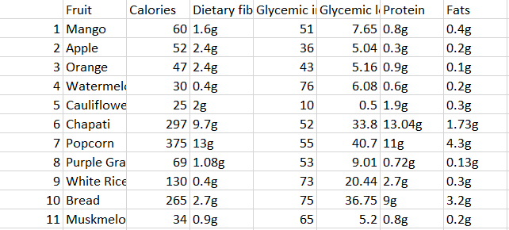
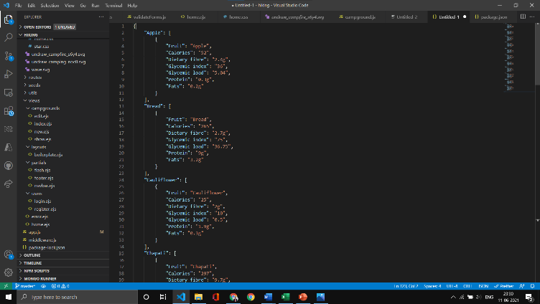
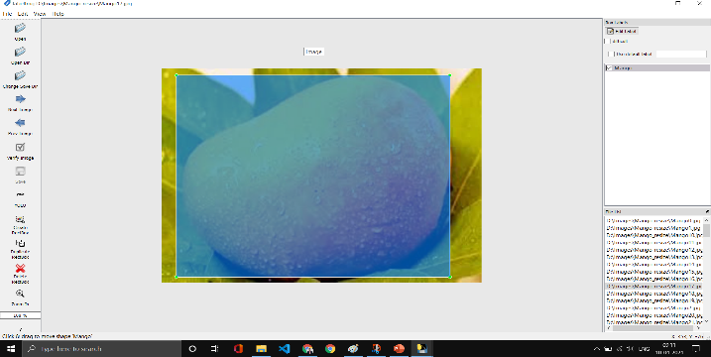
DATASET
Creation of Dataset –
Collection of 100 images
Resized
LabelImg (For labelling of Images).
Fig 5. Database (Excel format)
Fig 6. Database (Json format)
Fig 7. Image labelling)

Slide 8
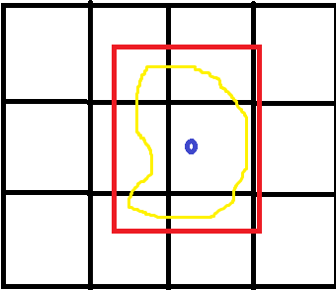
YOLO
Image Classification + Object Localization
Output Array
Pc
Bx
By
Bw
Bz
C1
C2
C3
Table 1. Output Array
Fig 8. Yolo grid

Slide 9
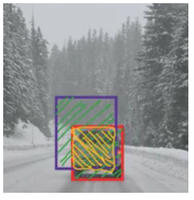
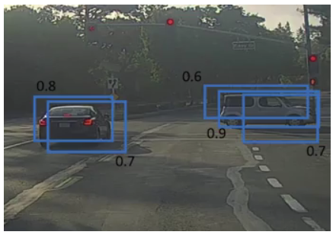
IoU AND NON-MAX SUPPRESSION
Intersection over Union is an evaluation metric used to measure the accuracy of an object detector on a particular dataset.
Any algorithm that provides predicted bounding boxes as output can be evaluated using IoU.
IoU = Area of the intersection / Area of the union.
Fig 9. Intersection over Union (IoU)
Fig 10. Non Max Suppression

Slide 10
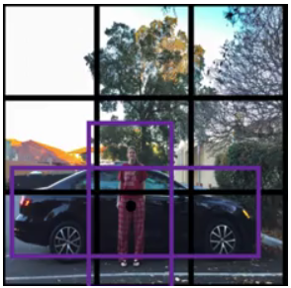
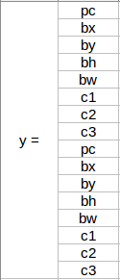
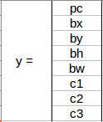
ANCHOR BOX
In order to predict and localize many different objects in an image, most state-of-the-art object detection models such as YOLO models start with anchor boxes as a prior and adjust from there.
Fig 11. Image with coinciding middle points
Fig 12. y label without anchor box)
Fig 13. y label with anchor box

Slide 11
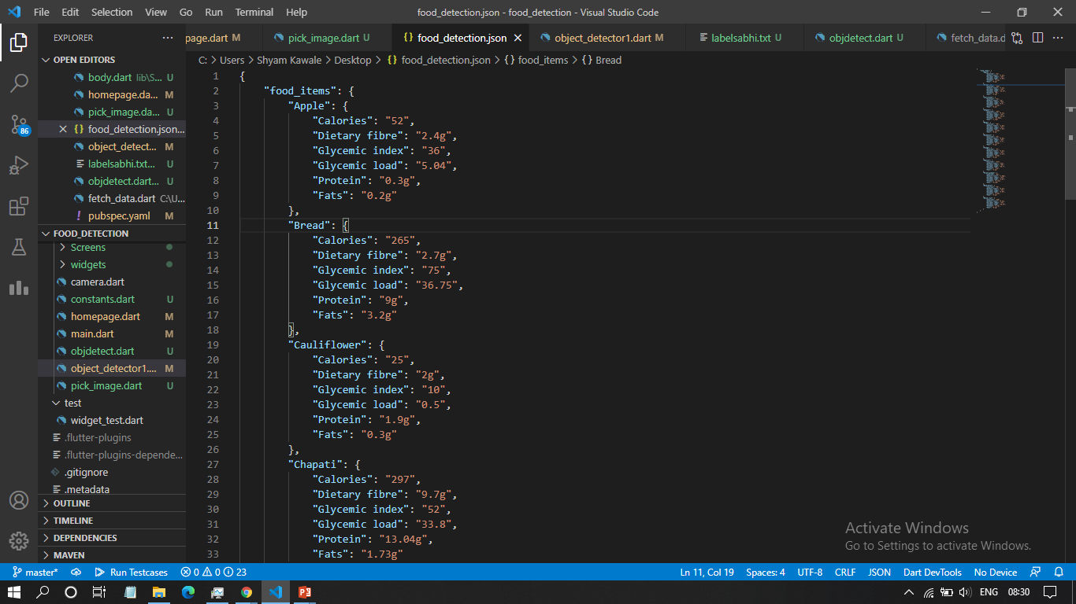
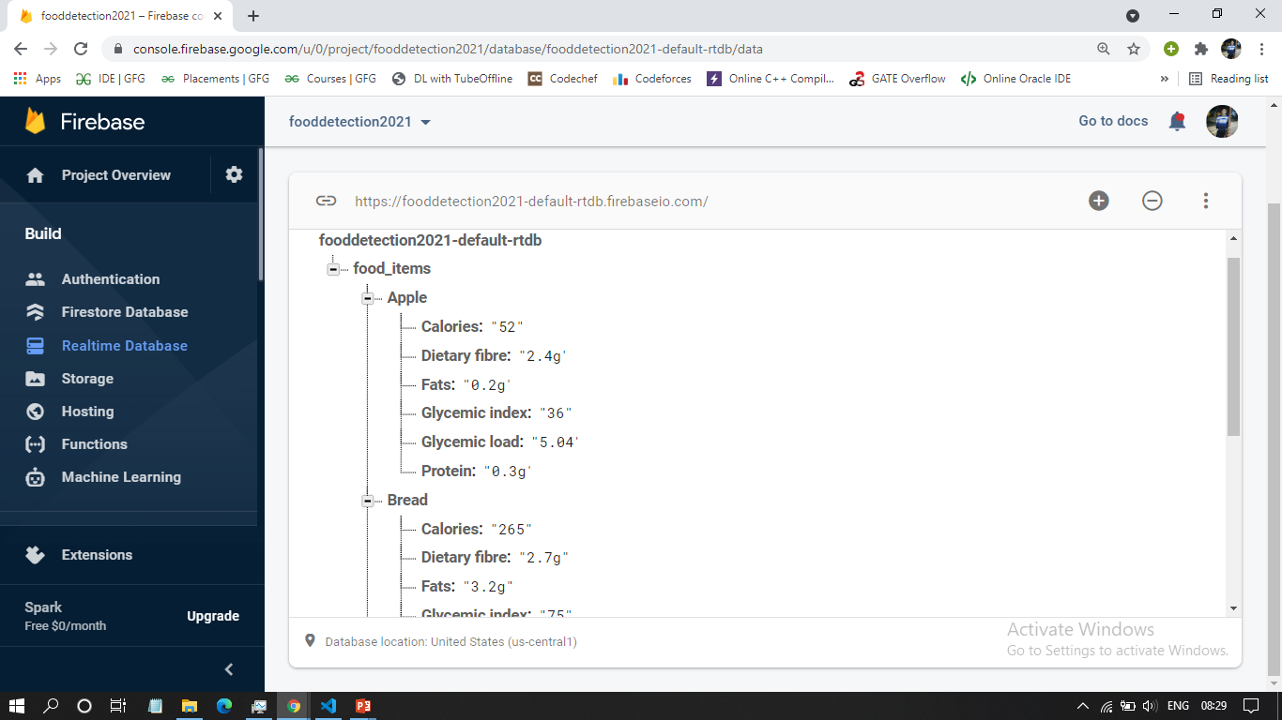
DATABASE
Fig 14. Firebase real time DB
Fig 13. Json form of Excel Sheet

Slide 12

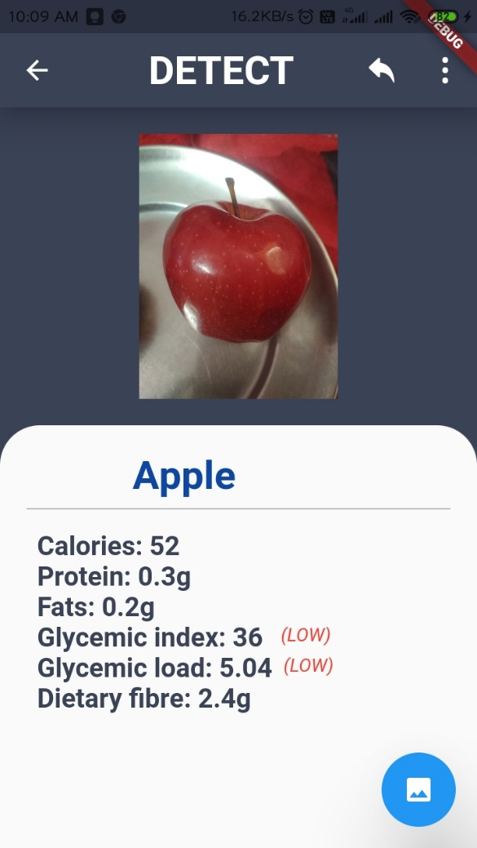



FLOW OF APP
Screen. B
Screen. A
Screen. D
Screen. E
Screen. C

Slide 13
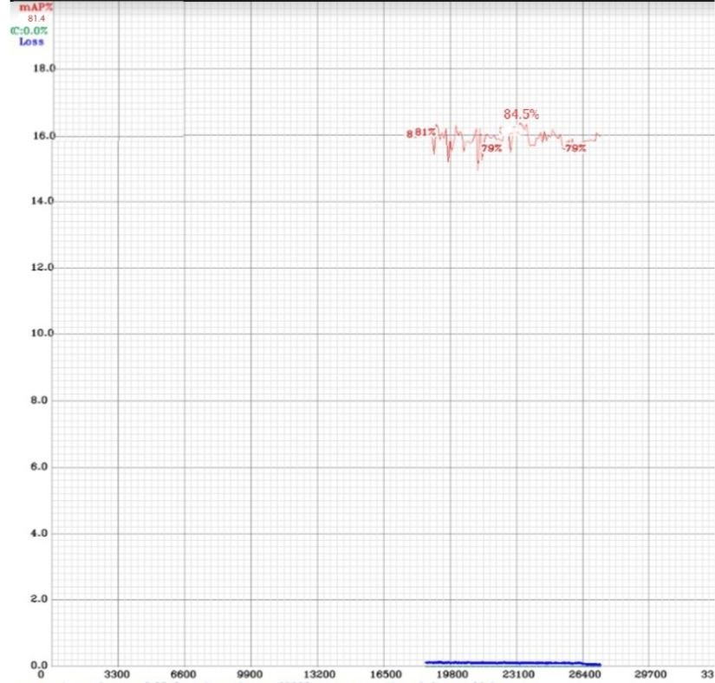
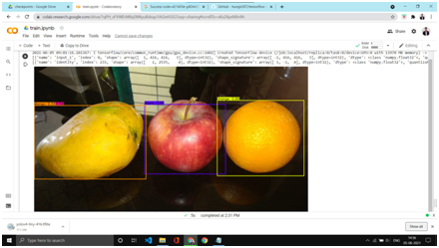
CONCLUSION
Android app recognizes 7 fruits and 4 different food items
According to detected fruit or food item, it gives nutritional content value
Accuracy of 88%
Fig 15. Accuracy (88%)
Fig 16. Output of several

Slide 14
FUTURE SCOPE
More categories of food can be included
Personalize your monitoring
Customer help
To include fitness plans
Calories can be estimated by volume.

Slide 15
REFERENCES
Park's Textbook of Preventive and Social MedicineBook by K. Park.
https://arxiv.org/abs/1506.02640 (visited on 12/02/2021)
https://lpi.oregonstate.edu/mic/food-beverages/glycemic-index-glycemic-load(visited on 11/03/2021)
https://medium.com/syncedreview/deep-learning-based-food-calorie-estimation-method-in-dietary-assessment-1e76a2acee7 (visited on 13/03/2021)
https://www.analyticsvidhya.com/blog/2018/12/practical-guide-object-detection-yolo-framewor-python/(visited on 13/03/2021)
https://www.pyimagesearch.com/2016/11/07/intersection-over-union-iou-for-object-detection/(visited on 13/03/2021)

Slide 16
LITERATURE SURVEY
[1] Calorie Prediction from Food Images, Manal Chokr, Shady Elbassuoni
[2] Semi-Automated System for Predicting Calories in Photographs of Meals, Patrick McAlister, Huiru Zheng, Raymond Bond, Anne Moorhead
[3] Ashu Gulati, Rahul Samant, Tushar Tank (2020), Calorie Estimation System Using Object Detection by Deep Learning Technique, International Journal of Future Generation Communication and Networking Vol. 13, No. 2s, (2020), pp. 1532–1537
[4] Y. He, C. Xu, N. Khanna, C. Boushey, and E. Delp, “Analysis of food images: Features and classification,” in IEEE International Conference on Image Processing, 2014, pp. 2744-2748.
[5] D. T. Nguyen, Z. Zong, P. O. Ogunbona, Y. Probst, and W. Li, “Food image classification using local appearance and global
[6] T. Joutou, and K. Yanai, “A food image recognition system with Multiple Kernel Learning,” in 16th IEEE International Conference on Image Processing, 2009, pp. 285-288.
[7] H. Chen, J. Xu, G. Xiao, Q. Wu, and S. Zhang, “Fast auto-clean CNN model for online prediction of food materials,” Journal of Parallel and Distributed Computing. Kidlington, 2017, in press.

